Slide 1
Databases and Backend Servers
Fun Time with SQL, Java Spring, and IntelliJ

Slide 2
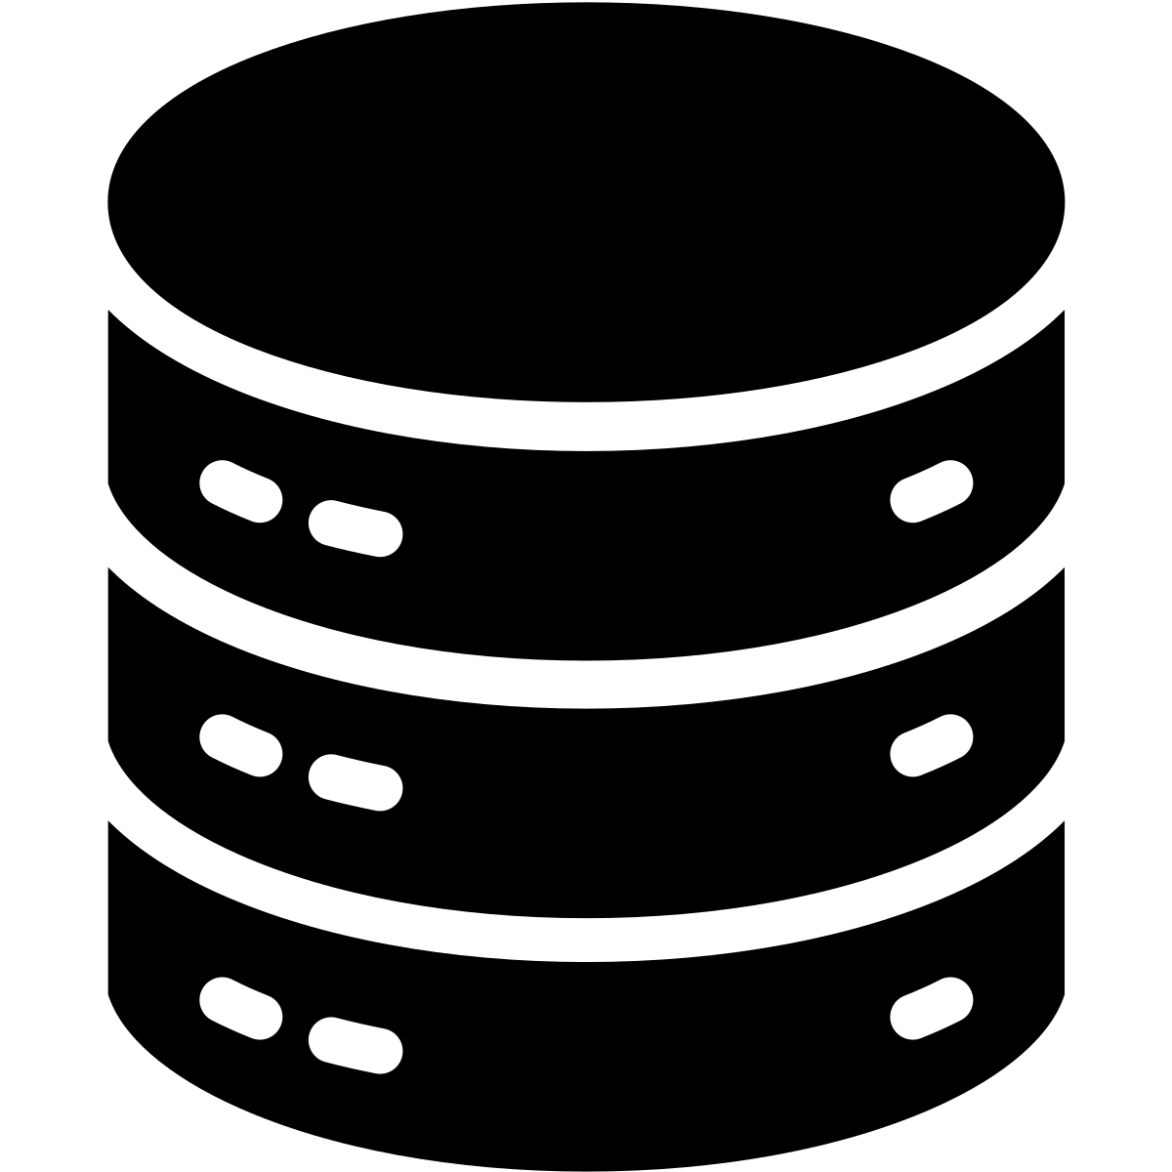
Database Servers
Servers, local or remote, run databases and allow connections
localhost
Amazon RDS, ElephantSQL, etc.

Slide 3
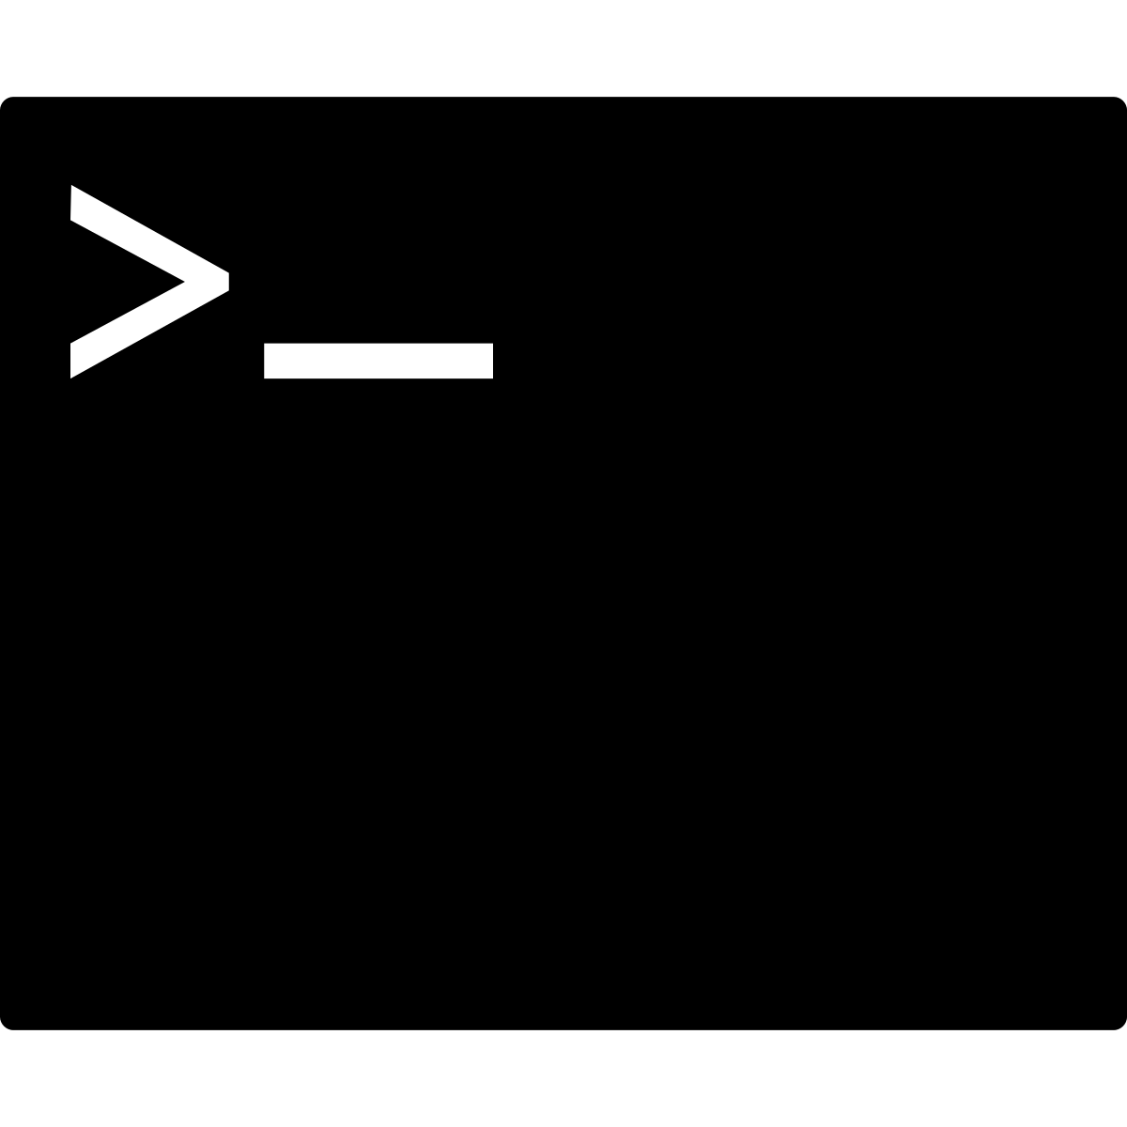


Connecting to the Database Server
Terminal
Usually, though, we use a terminal or a specific tool designed for the type of database you are accessing.
Each database language or dialect typically releases its own tool. pgAdmin is the tool for PostgreSQL.
Database Server
pgAdmin
Postico

Slide 4
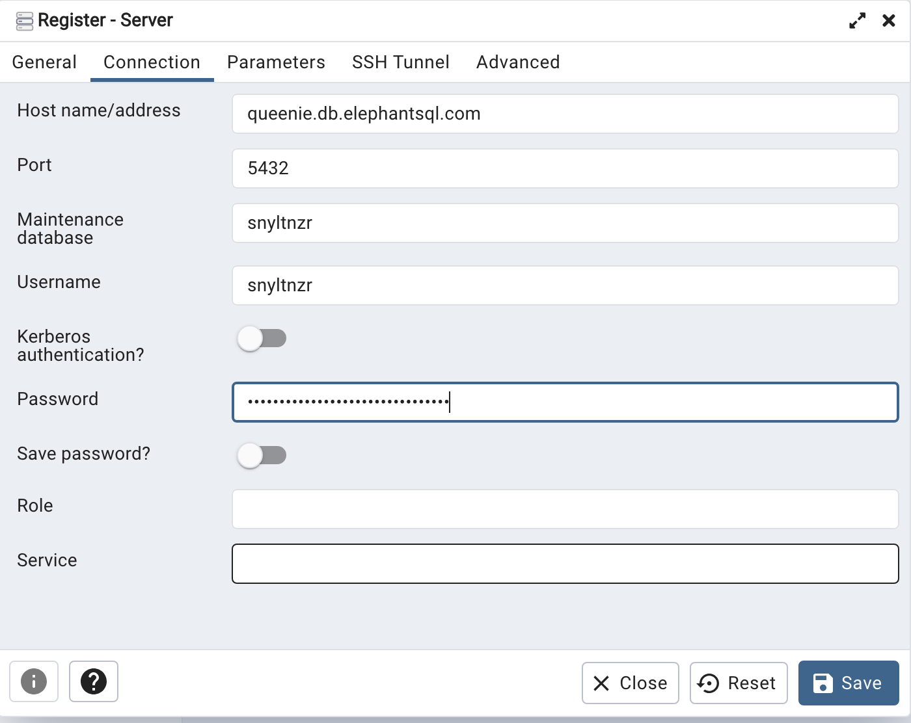
Connecting Through pgAdmin
To connect, we register a server by entering the following information:
Host address (local or remote)
Port (almost always 5432)
Database name
Username
Password

Slide 5
What We Can Do Once We’re In
Data Definition Language (DDL)
Create, drop, and alter tables
Create and drop views
Create and drop sequences
Create and drop functions
Data Manipulation Language (DML)
Create rows in tables (INSERT)
Read data from tables (SELECT)
Update data in tables (UPDATE)
Delete data from tables (DELETE)

Slide 6

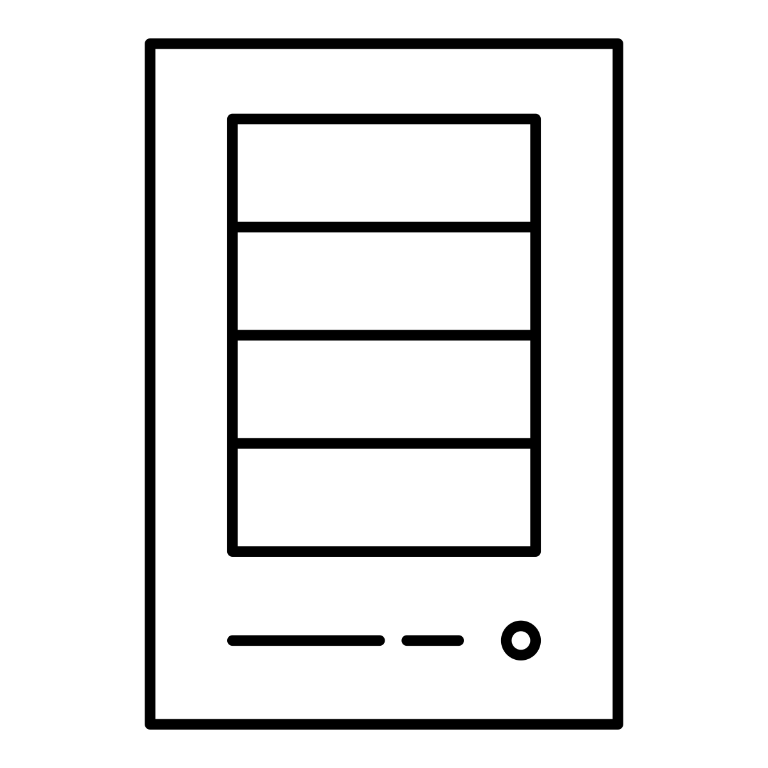

Connecting to the Database through Apps and Server
Apps usually use direct traffic through a backend server to a database.
Web Apps
Backend Servers
Database Server
Mobile Apps

Slide 7
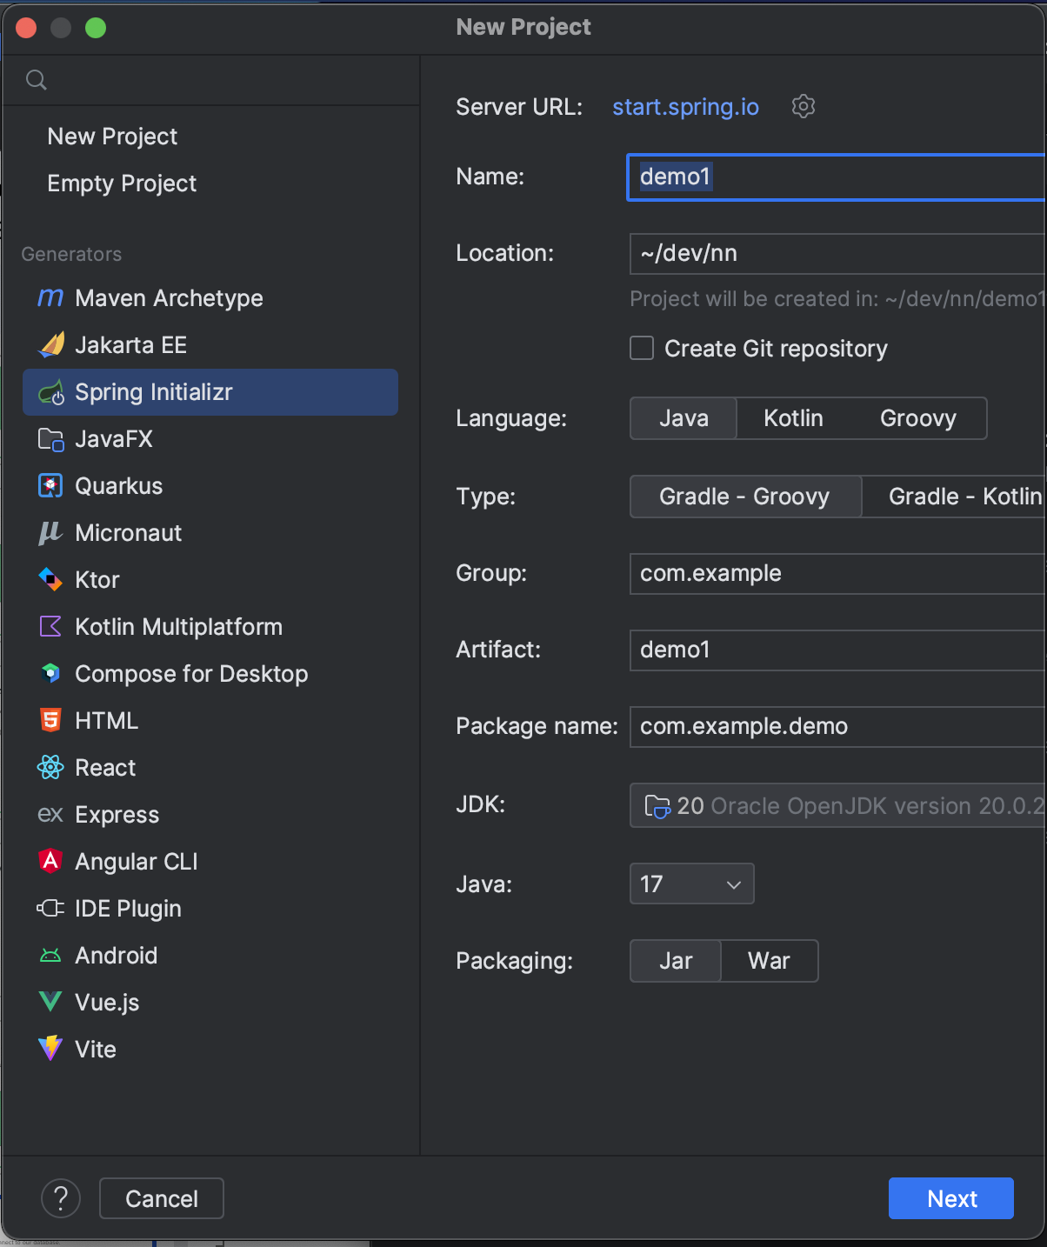
The Server
Let’s create the server that will connect to our database.
Open IntelliJ and create a new project.
Select Spring Initializr.
Give the project a name.
Select Maven as the Type.
Click Next.

Slide 8
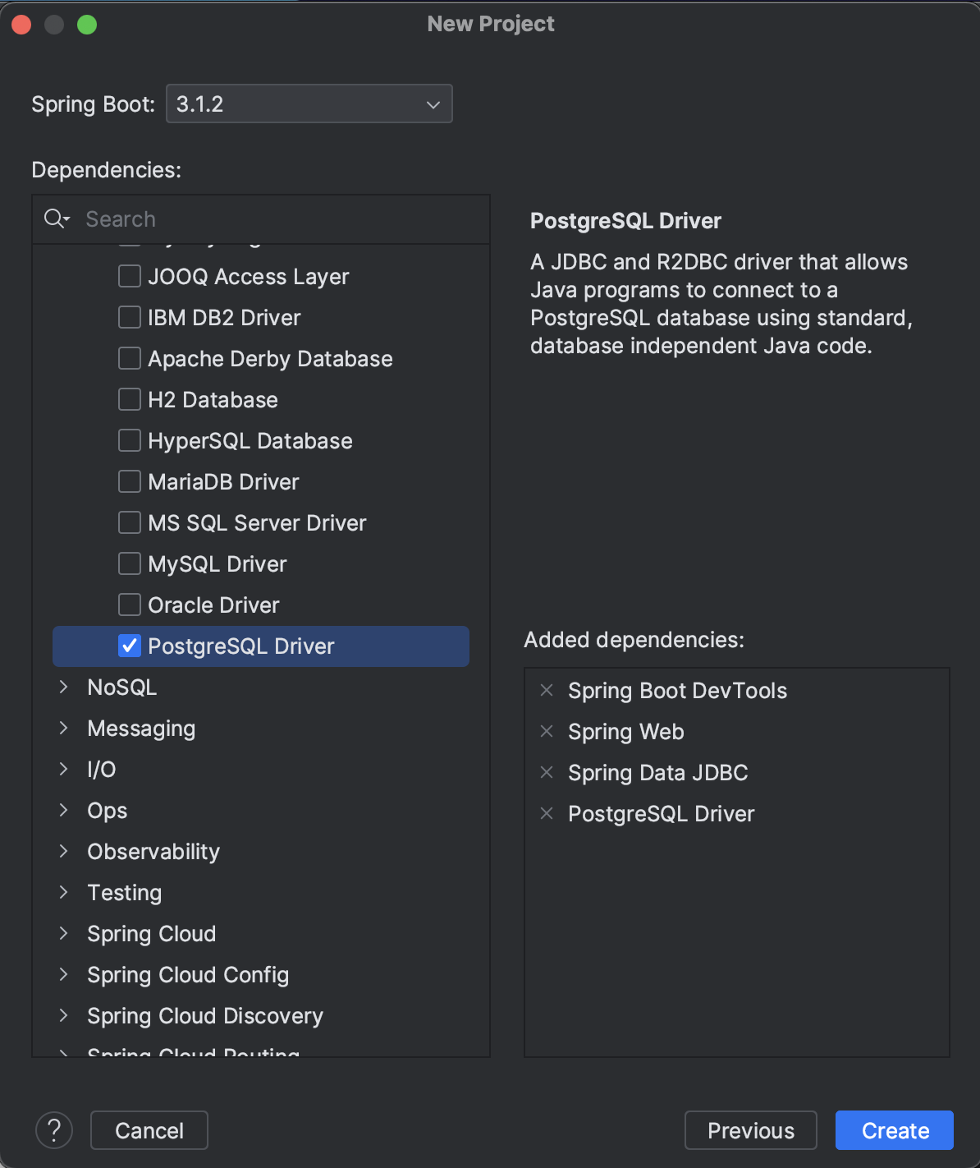
Project Dependencies
Install the dependencies we need for our backend:
Spring Boot Dev Tools
Spring Web
Spring Data JDBC
PostgreSQL Driver

Slide 9
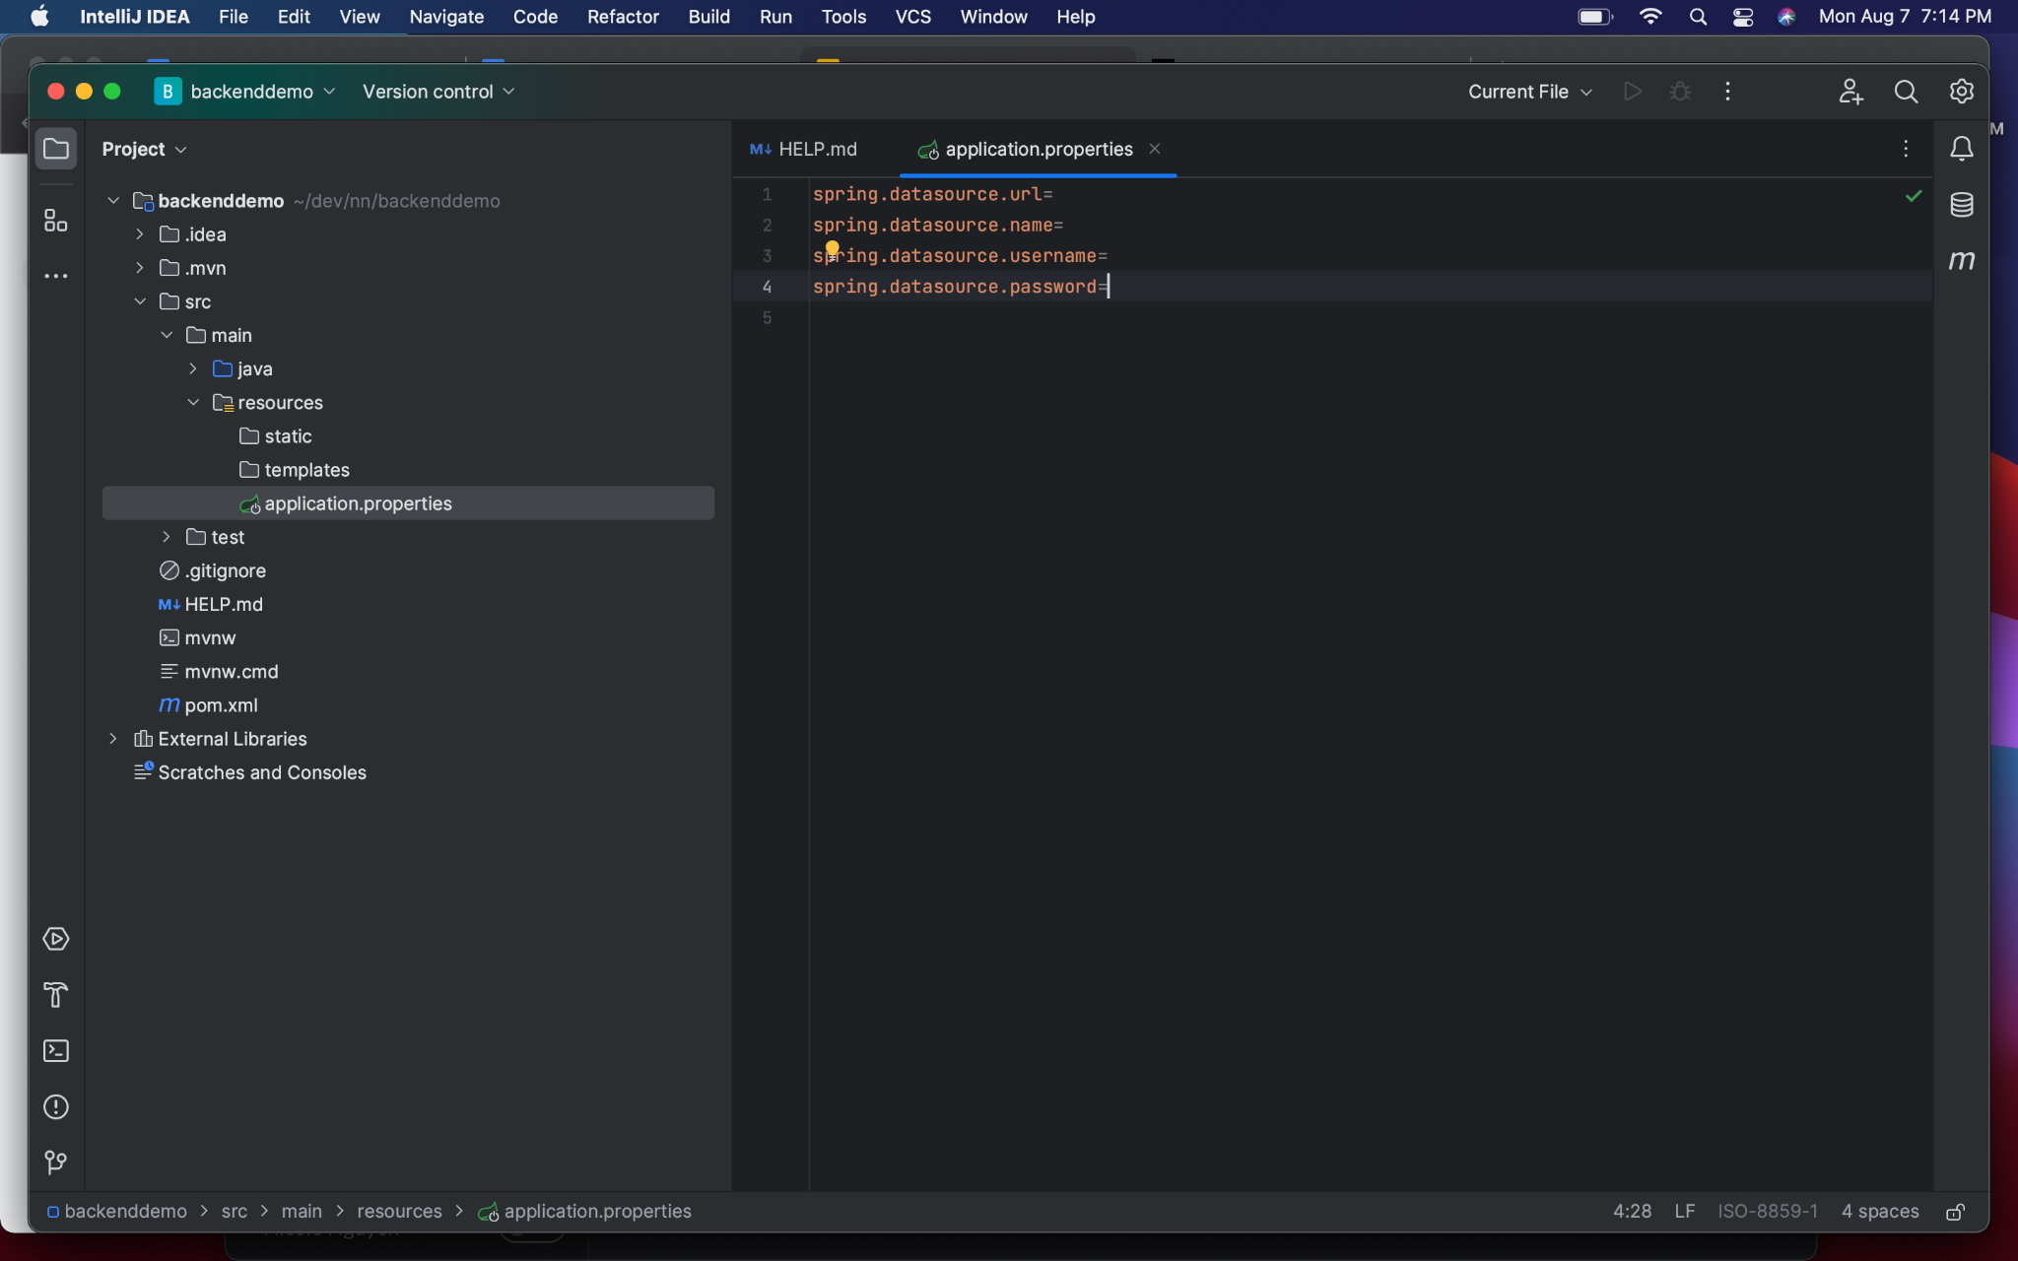
Hook up the database
As with pgAdmin, we need a few values to connect our database:
URL (host address)
Name (database name)
Username
Password

Slide 10
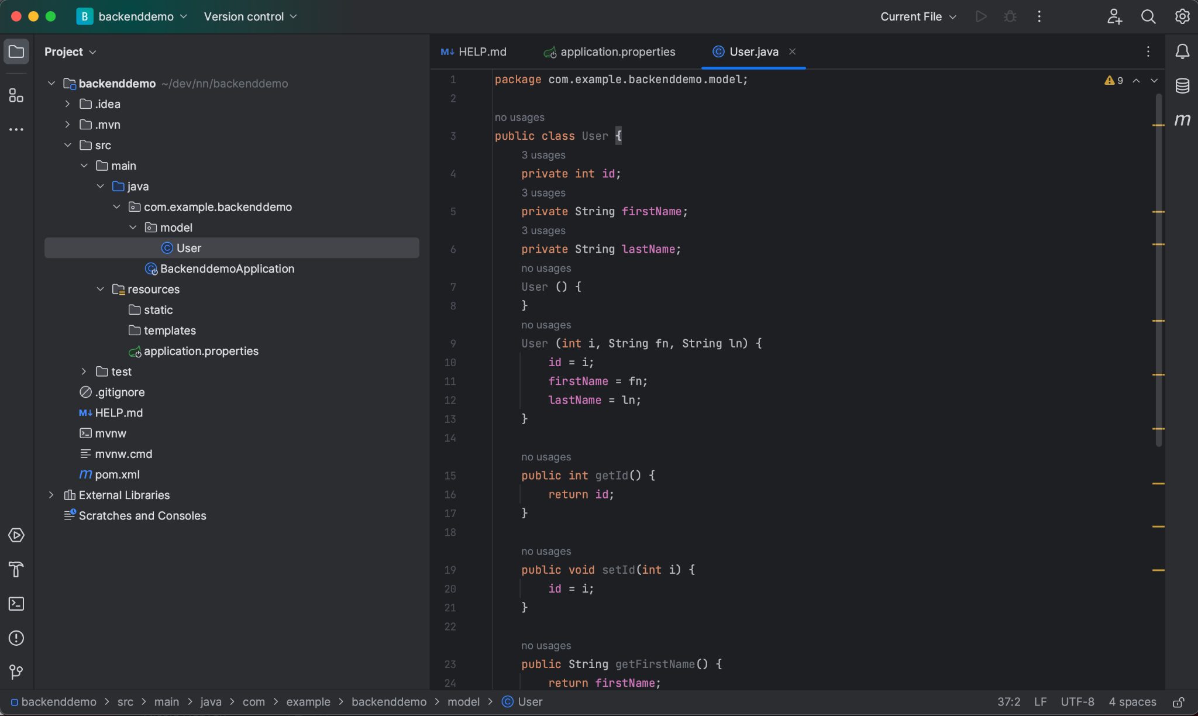
Set up a Model
This class defines the way your app will store, manipulate, and provide data to the app.

Slide 11
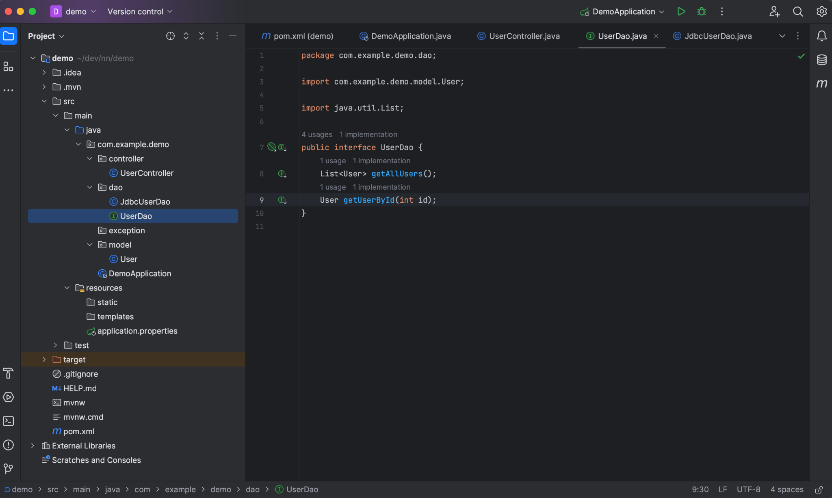
Set up a Data Access Object (Interface)
This interface tells the rest of your app (particularly the controller) what methods it can call to get the data from the database. These methods use the model to specify the return value of the methods.
Most importantly, this DAO hides the details of the database from the rest of the app. So the controller doesn’t need to know how to talk to the database directly.

Slide 12
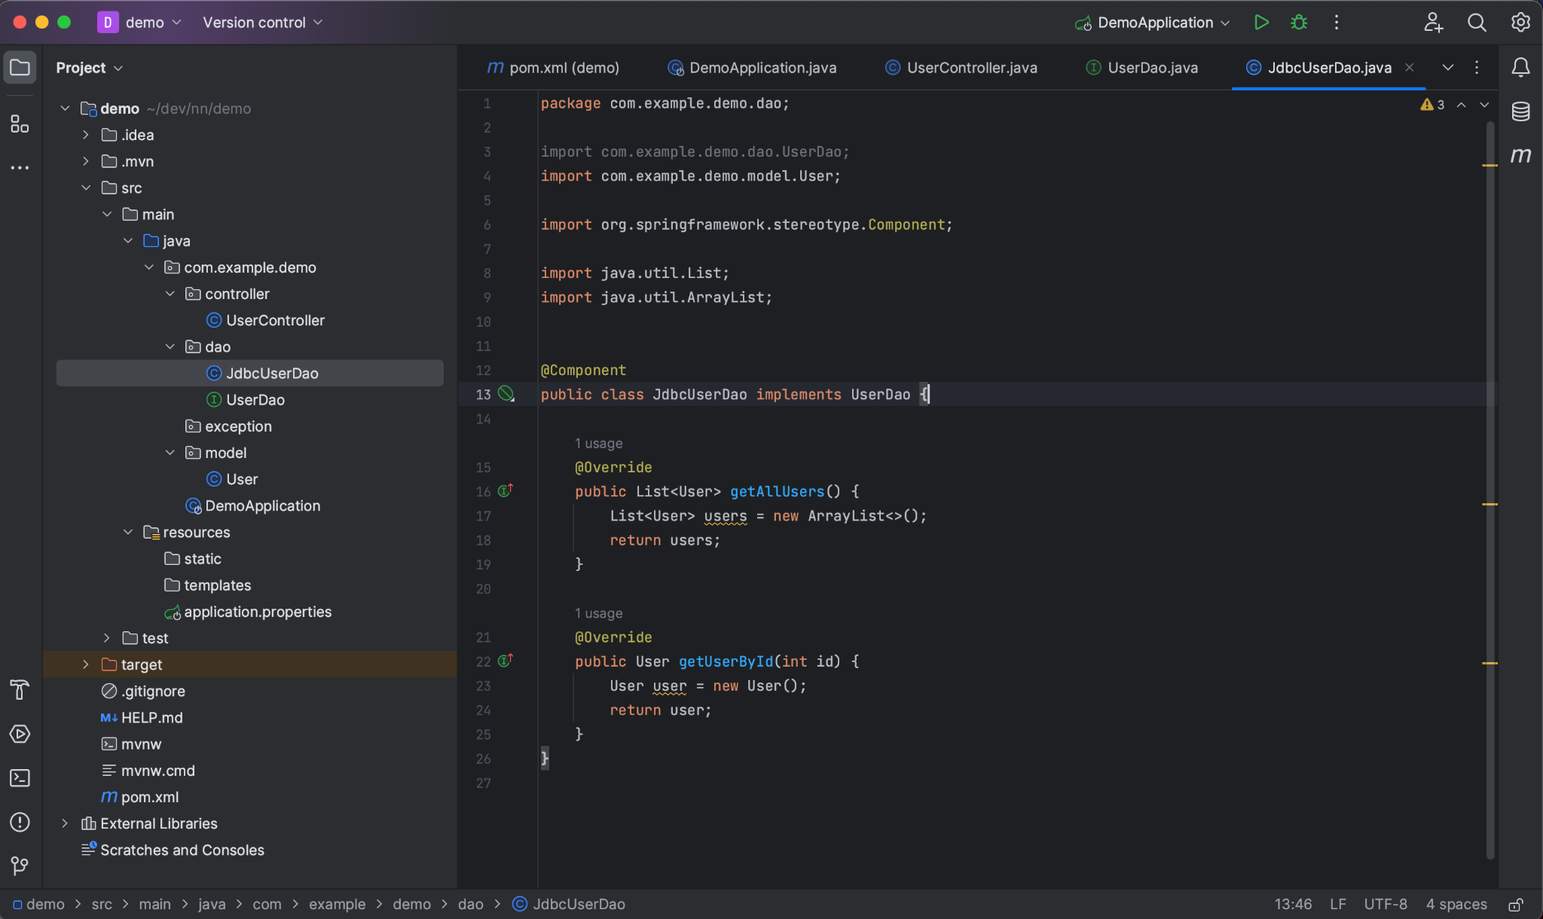
Set Up the Implementation of the DAO Interface
This class implements the DAO interface (you guys called it a JDBCModelDao) Here we finally specify how to get the data from the database and transform it into the model(s) that the rest of the app expects.
(In our project, we still need to add methods to query the database.)

Slide 13
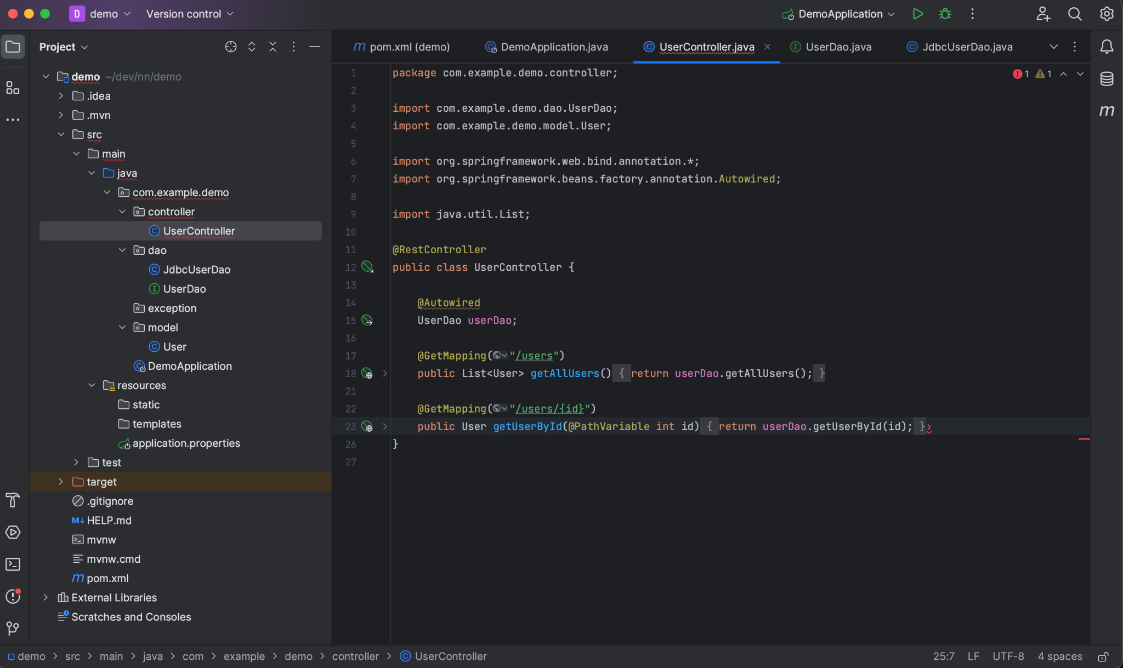
Add the Controller
The controller will register API endpoints for our app. Here we can import the DAO. (We’ve used some Spring magic to import the abstract DAO, but actually get the concrete implementation instance under the hood.)
The controller simply needs to use the interface’s methods to return the appropriate data.

Slide 14
What’s going on here?
Here’s the flow:
Controller
GET /users
GET /users/{id}
UserDao
getAllUsers -> List<User>
getUserById -> User
JDBCUserDao
getAllUsers -> SELECT * FROM users
getUserById -> SELECT * FROM users WHERE id = ?
Model
Defines the properties and methods of User for all other classes to consume and speak the same “language” when it comes to users.

